Slide 1
The No-U-Turn Sampler: Adaptively Setting Path Lengths in Hamiltonian Monte Carlo
Authors: Matthew D. Hoffman, Andrew Gelman
Presenters: Chris Benton, Robert Garrett

Slide 2
Paper Background
Published 2014 in JMLR
Matthew D. Hoffman
PhD Princeton Computer Science
Post doc at Columbia working under Gelman
Currently Senior Research Scientist at Google
Andrew Gelman
PhD Harvard Statistics
Professor of Statistics at Columbia
No U-Turn Sampler is abbreviated as NUTS
Implemented in Stan

Slide 3
Problem of Interest
Fitting a statistical distribution to a dataset
Mathematical methods vs Simulation-based methods
Why do we care?
Mathematical methods are difficult for complex data models
Mathematical Methods
Traditional (Frequentist) Methods
Bayesian Inference
Simulation-based Methods
Monte Carlo Simulation
Markov Chain Monte Carlo
Hamiltonian Monte Carlo
Notes:
Distribution fitting and parameter estimation
What is this distribution of a population, given the sample I have?
What if I have useful prior knowledge about that distribution?
Applications of parameter estimation:
Inference: What is typical or extreme value for this population?
Predictive Modeling: How can we model one variable using others?
How can we fit a distribution to our data?
Traditional (Frequentist) Methods
Bayesian Inference
Monte Carlo Simulation
Markov Chain Monte Carlo
Hamiltonian Monte Carlo

Slide 4
History of MCMC leading to NUTS
Monte Carlo methods (1946)
Metropolis algorithm (1953)
Metropolis-Hastings (1970)
Gelman and Smith (1990)
No-U-Turn Sampler (2014)
Notes:
Monte Carlo methods used to solve largely intractable combinatorial problems (probability of winning solitaire)

Slide 5
Hamiltonian Dynamics: Real World Physics
Position: (x,y) coordinates and height z
Potential energy: based on the height of given position
Momentum: Mass * Velocity
Kinetic energy: based on momentum
Level surface: Kinetic energy stays constant
Incline: Kinetic energy decreases; Potential energy increases
Decline: Kinetic energy increases at expense of Potential energy
Example: drop a marble into a bowl
Marble will settle at the bottom of the bowl! (Local minima)

Slide 6
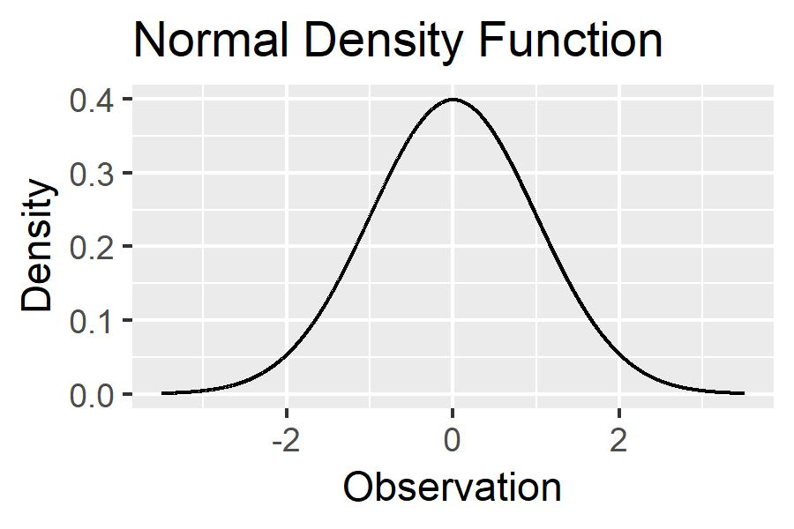
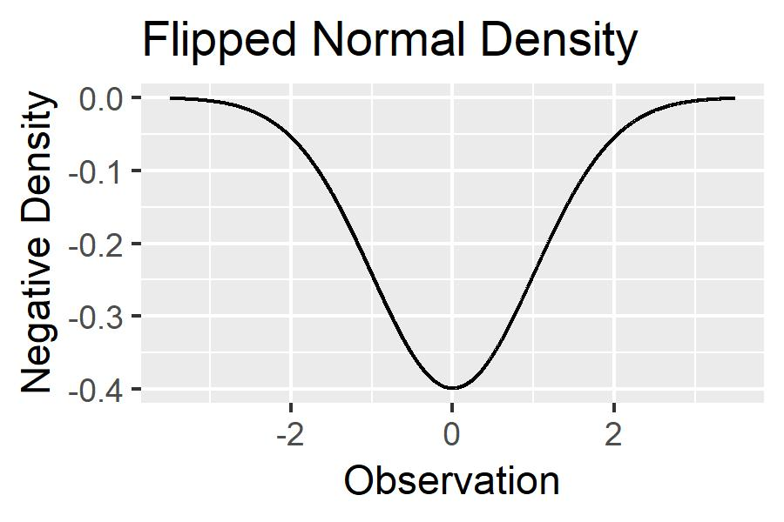
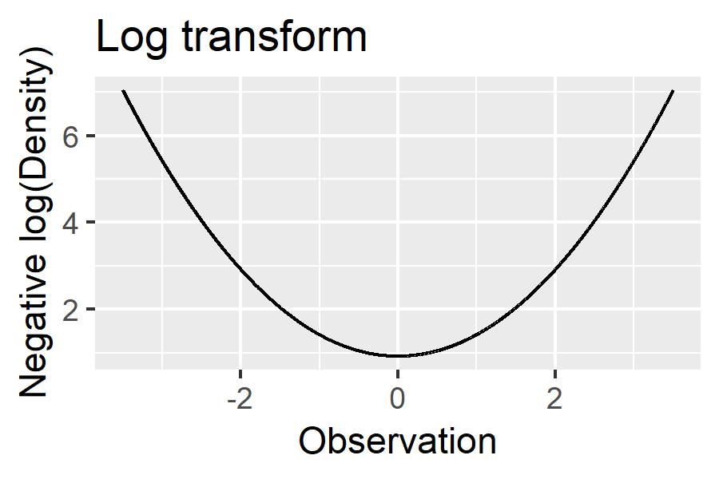
Hamiltonian Monte Carlo
Simulate model parameters using Hamiltonian Dynamics
Position: Now a set of model parameters
Momentum: We randomly select velocity for each parameter
Now we can explore the parameter space by treating the joint density as a n-dimensional surface!
Goal: Explore the parameter space in full
Problem: our position will roll to a stop at a local minimum

Slide 7
Hamiltonian Monte Carlo
Use our exploration of the parameter space to create a posterior sample
First, must discretize the system:
ε: step size
L: number of steps to take before stopping
Leapfrog method to approximate movement
Take L steps of size ε, approximating the system using Leapfrog
Accept or Reject the new state:
If the new state has a higher probability, keep it
Otherwise, keep it with probability proportional to the decreased probability

Slide 8
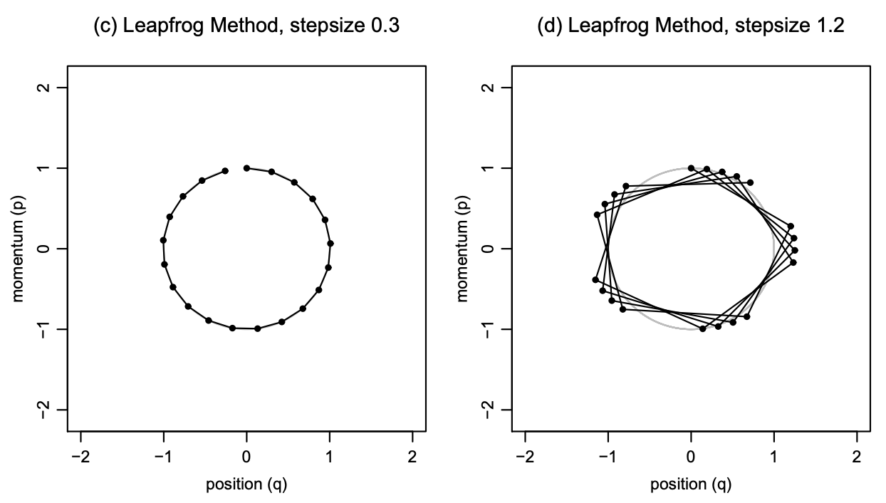
Limitations of HMC
Highly sensitive to step size, ε, and number of steps, L
If L is too small, the simulation exhibits random walk
If L is too large, the simulation wastes computation
Computing an appropriate ε is expensive
Notes:
Highly sensitive to step size (ε) and number of steps (L)
If L is too small, algo exhibits random walk
If L is too large, algo wastes computation

Slide 9
No U-Turn Sampler
NUTS was specifically designed to fix these limitations
Step Size:
NUTS adaptively sets the step size
Eliminates the need for costly model tuning
No U Turn:
Steps will terminate when leapfrog leads to backtracking
Eliminates wasted computations
Acceptance Criteria:
No single step to accept/reject; NUTS uses an alternative statistic
Average acceptance probability of each state’s position/momentum in HMC
Notes:
Eliminates need to set L
Stops automatically when ‘search’ starts to backtrack (if angle of approach is too steep)
Adaptively change ε on the fly

Slide 10
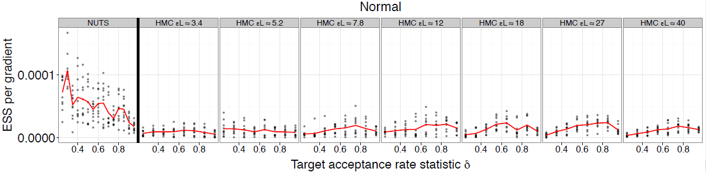
Results
Larger Effective Sample Size with less computations
Translation: Better simulation in quicker time
NUTS performs as well as, if not better than, selectively choosing L and epsilon

Slide 11
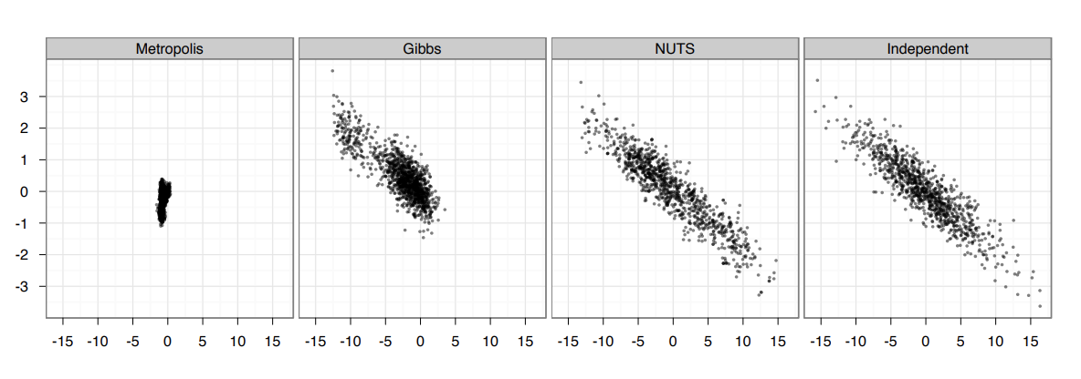
Results
Comparison of MCMC methods generating independent samples

Slide 12
Real World Applications
Physical simulations
Spatial statistics
Image analysis
Integration of unknown parameters in Bayesian statistics
Simulating (approximating) high dimensional integrals
Notes:
First used to simulate the distribution of states in a system of molecules

Slide 13
Future Work
Problem: Simulating multi modal distributions
Two stage simulation, avoiding already explored areas?
Further transformations of the posterior density?
Problem: Leapfrog method may still have notable error
Improve upon the leapfrog method using higher order methods?
Problem: NUTS and HMC cannot sample discrete parameters
Notes:
Possibly taking large, random steps into unexplored space

Slide 14
Resources
Interactive explanation and visualization of MCMC and HMC
http://arogozhnikov.github.io/2016/12/19/markov_chain_monte_carlo.html
R Programming language
https://www.r-project.org
RStan sampler
http://mc-stan.org/users/interfaces/rstan

Slide 15
References
Hoffman, M. D., & Gelman, A. (2014). The No-U-turn sampler: adaptively setting path lengths in Hamiltonian Monte Carlo. Journal of Machine Learning Research, 15(1), 1593-1623.
Stan Development Team (2018). RStan: the R interface to Stan. R package version 2.18.2. http://mc-stan.org/.
Robert, Christian; Casella, George. A Short History of Markov Chain Monte Carlo: Subjective Recollections from Incomplete Data. Statist. Sci. 26 (2011), no. 1, 102--115. doi:10.1214/10-STS351. https

Slide 16
Questions?

